Slide 1


Database Build and Release (with Jenkins CI and SQL Source Control) will get started soon
#sqlinthecity
Ernest Hwang
Principal Software Engineer, Practice Fusion
http://practicefusion.com/careers/

Slide 2

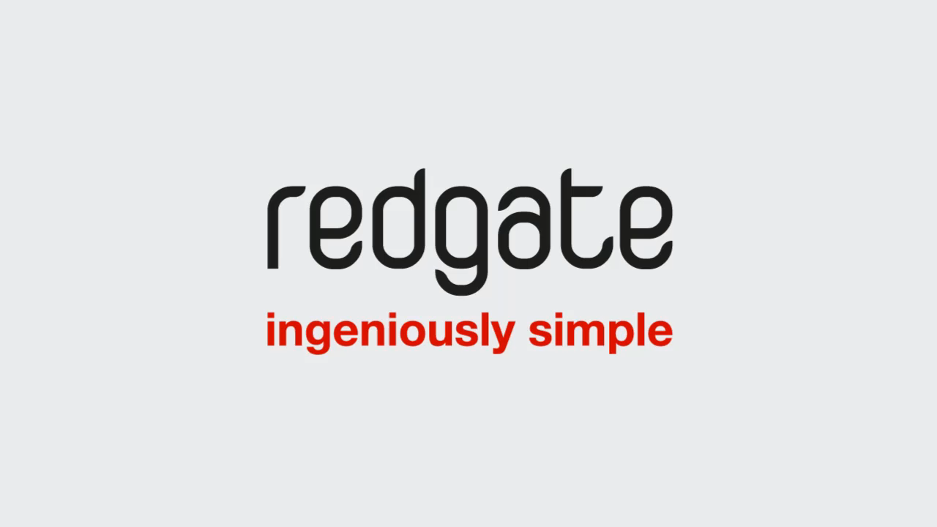
While you’re waiting, check out SQL Prompt
#sqlinthecity

Slide 3
While you’re waiting, go on Twitter
#sqlinthecity
Tweet us at @redgate #sqlinthecity and let us know how you’re enjoying the event, speakers, sessions,
food, demos and more
@redgate | #sqlinthecity

Slide 4

Enjoy the session
Be sure to note down/tweet your questions to ask the speaker during the Q&A at the end of the session
#sqlinthecity

Slide 5
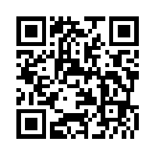
Once you’ve viewed today’s sessions, please complete the online feedback form
#sqlinthecity
www.red-gate.com/sitc13-feedback
In return you can:
Collect a Red Gate book of your choice from 5PM
Have a chance to win a Conference pass to SQL Server LIVE! 2013, which will be drawn at 5.15PM

Slide 6

Practice Fusion is Hiring!
Stop Playing Games. Start Saving Lives.
SQL Server, C#, WCF, ASP.net MVC, Ruby on Rails, Ember.js
Positions available in San Francisco, Palo Alto and Seattle.
http://practicefusion.com/careers/

Slide 7
Who am I?
Ernest Hwang, Principal Software Engineer at Practice Fusion in San Francisco (We’re Hiring!)
C#, .NET Developer since 2001
SQL Server Developer since 1999 (SQL Server 6.x)
Using Red Gate for Continuous Integration since June 2011

Slide 8
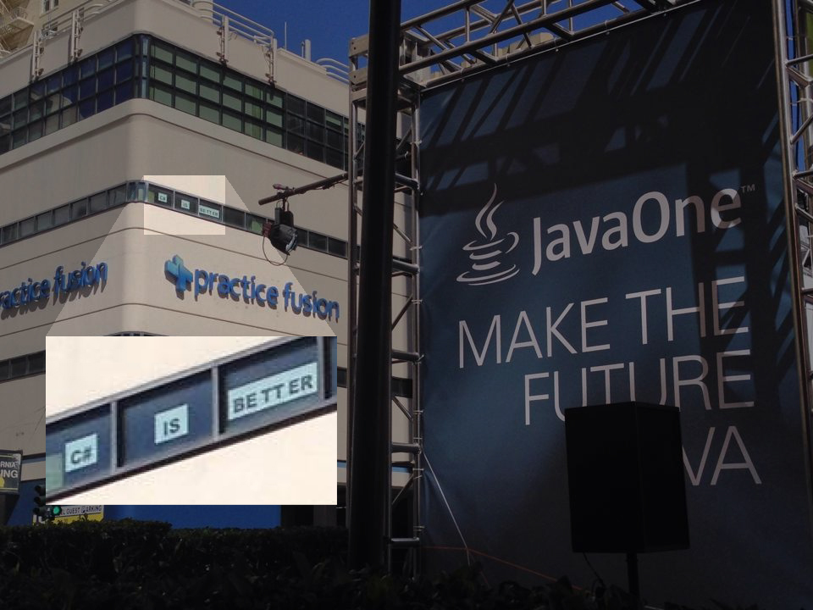
About Practice Fusion

Slide 9

Why am I here?

Slide 10

What is this?
A “How To” guide for automating your day-to-day maintenance tasks by…
*Easily* Versioning your database using Red Gate SQL Source Control
Using Continuous Integration (via Jenkins) to validate Database builds
Using Jenkins to automate database deployments
Using CI / tSQLt / SQL Test to run unit tests

Slide 11

Prerequisites
Experience with source control management systems (svn, TFS, git, Hg)
Familiarity with Continuous Integration Products (Jenkins, Team City, Cruise Control)
Awareness of build scripting languages (ant, MSBuild)

Slide 12
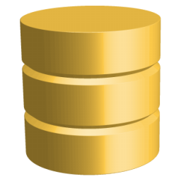





What software is used?
SQL Server 2008 / 2012
Red Gate SQL Source Control
Red Gate SQL Compare
Red Gate SQL Data Compare
Jenkins Continuous Integration Server http://jenkins-ci.org/
Promoted Build Plugin
Copy Artifacts Plugin
Version Plugin
Git Plugin
MSBuild

Slide 13
What is SQL Source Control
Source Control plug in for SQL Server Management Studio
Creates a “snapshot” of the database schema defined by CREATE scripts
Snapshot is consumable by SQL Compare and may be used to compare against the schema of an actual database

Slide 14


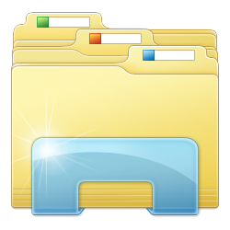

What is SQL Source Control?
SQL Source Control is to SSMS as TortoiseSVN is to Windows Explorer

Slide 15
Demo Environment
GitHub
Build and Database Server (Windows Azure VM)
Developer Workstation
Local Copy of RGDemo database
Dev, QA, & Prod Databases

Slide 16
Commiting Changes to Source Control
Demo
Commit Changes via SQL Source Control
Changes committed to SCM repository
Local Database
Changes

Slide 17
How does Continuous Integration fit in?
The CI server polls the repository for changes
When changes are checked in, the CI job kicks off
Verifies that the database can be built
Builds a brand new database from scratch using SQL Compare and SQL Data Compare
Runs unit tests
Build should fail if unit tests do not succeed
Archives the artifacts (for deployments)
Artifacts can include build/test reports
Emails engineers if there are problems

Slide 18

I’M THE ONE WHO DROPS TABLES! (demo)

Slide 19
Deploying Changes to Different Environments
The Promoted Builds plug in can be used to deploy changes to Integration/QA/Staging/Production environments
SQL Compare and SQL Data Compare are used to deploy changes between the sourced controlled database and your development environments
Deploying to Production and/or Staging can be configured to just create the scripts as opposed to forcing the synchronization

Slide 20
Deploying to Dev / QA
Demo
SQL Source Control
Repository
SQL Compare
Development Environment
Database

Slide 21
Creating a Database “Version”
Make sure the Jenkins Versioning plugin is installed
Create a User Defined Function called dbo.DATABASE_VERSION()
Create a build step that updates the UDF with the version number
The updated UDF will be archived and used with deployments

Slide 22


Versioning your Database
Demo
Commit Changes via SQL Source Control
Build Task updates
dbo.DATABASE_VERSION() Function
CI Server Detects Changes
Kicks off Build Process
Updated UDF Archived

Slide 23

Unit Testing with tSQLt and SQL Test
tSQLt is an open source set of stored procedures and functions to facilitate Unit Testing in SQL databases
SQL Test is a wrapper around this framework that integrates with SSMS
Your build server can enforce that your unit tests pass and generate reports

Slide 24

Unit Testing with tSQLt / SQL Test
Demo
Commit Changes via SQL Source Control
Build Task executes
Unit Test procedures
CI Server Detects Changes
Kicks off Build Process
Tests can pass or fail the build

Slide 25
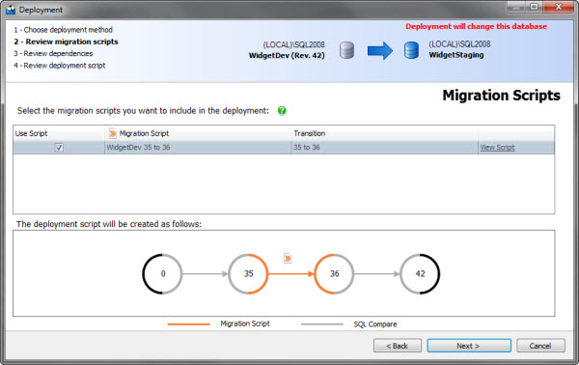
Migrations

Slide 26

Springer’s Final Thought
Saves developers time (yay!)
No more maintaining update scripts
Don’t need to deploy scripts when QA needs changes
Identifies holes in your deployment process
Are developers or DBAs making changes directly to production?
Are indexes/constraints missing from your Dev/QA/Prod environments?
Creates a definitive database build that can be easily deployed and redeployed

Slide 27
Considerations
Environments must be pristine
Process must be changed and understood
Production change scripts should be scrutinized (especially for the first few releases)
Migration Scripts can be used to massage data
DB Replication requires more work for promotions

Slide 28



Appendix 1: Other CI Servers
Jenkins (open source)
Team City (JetBrains)
Bamboo (Atlassian)
CruiseControl / CruiseControl.NET (open source)

Slide 29
Appendix 2: Other Source Control Systems
Subversion (SVN)
Git
Team Foundation Server
Mercurial (Hg)
AccuRev
Surround SCM

Slide 30




Links / Contact Info
ehwang@practicefusion.com
@ernestedcode
https://github.com/CF9/Databases.RGDemo
Practice Fusion is Hiring (email me) http://practicefusion.com/careers/
facebook.com/practicefusion
@practicefusion

